Slide 1
Introduction to Blockchain Programming
Dr. Adnan IMERI Technical Lead, INFRACHAIN and Luxembourg Blockchain Lab (LBL)
Disclaimer: This training intends explanation of technological advancements, and it does not intend any financial advice toward cryptocurrency or any digital asset!

Slide 2
Blockchain Immutability- Recall
DEMO
Hash
Block
Distributed/Immutability

Slide 3
Table of Contents
Development and Deployment Environment Setup

Slide 4

Development Environment Setup
Meta Mask Installation and Configuration
Test Blockchain Ganache
Remix IDE
Development Environment
Truffle
Hardhat

Slide 5
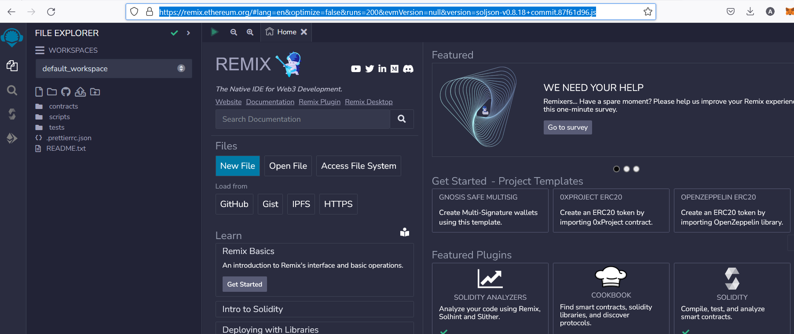
Remix IDE
Remix IDE – Browser IDE for Smart Contract Development

Slide 6
Remix IDE Components
Contract
A folder to hold Smart Contract
Develop
Compile
Deploy
Scripts
generated to deployment
Tests
“Unit test”
type of software testing
focuses on individual units or components of a software system
Aim: Validate each unit of software

Slide 7
Truffle – Deprecated 🡪Hardhat
Installation: https://trufflesuite.com/docs/truffle/how-to/install/

Slide 8
HardHat
A development environment that facilitates building on Ethereum
JavaScript
CLI Terminal
Smart Contact
Metamaks
Ready for the Smart Contract development

Slide 9
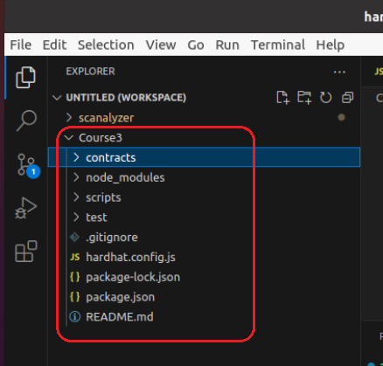
HardHat
Hardhat is installed by using Node.Js (via NPM)
🡪 Online repo
mkdir Course3
cd Course3
npx hardhat init
🡪 Create a JavaScript project
Now hardhat is installed and ready for use
Tasks and plugins are key to the design of Hardhat. The majority of Hardhat's functionality is provided by plugins.

Slide 10
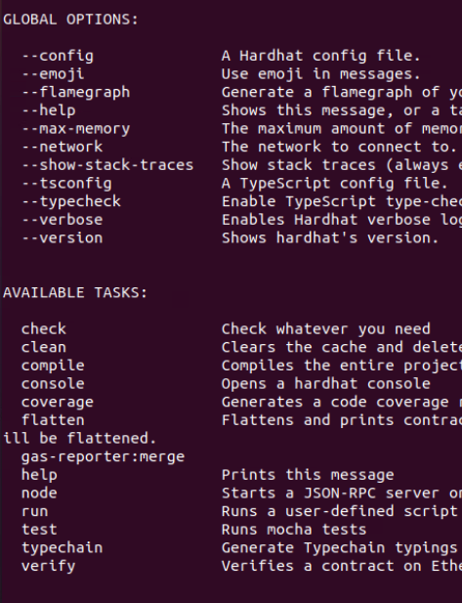
HardHat
Tasks and plugins are key to the design of Hardhat. The majority of Hardhat's functionality is provided by plugins.
Tasks
any commend line corresponds to task
npx hardhat “task name”
Try npx hardhat
Try npx hardhat –version
Plugins

Slide 11
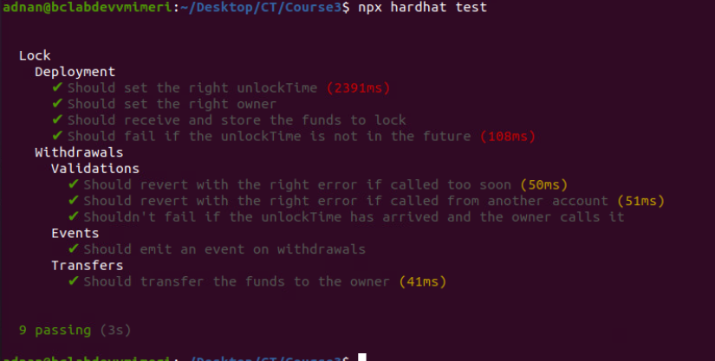
HardHat – Smart Contract
Course3/contracts/Lock.sol
Try npx hardhat compile
Course3/test/Lock.js
Tey npx hardhat tests

Slide 12
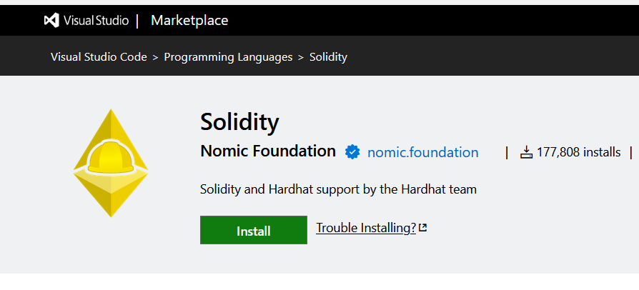
HardHat – Visual Studio Code
Install Hardhat into VC Code

Slide 13
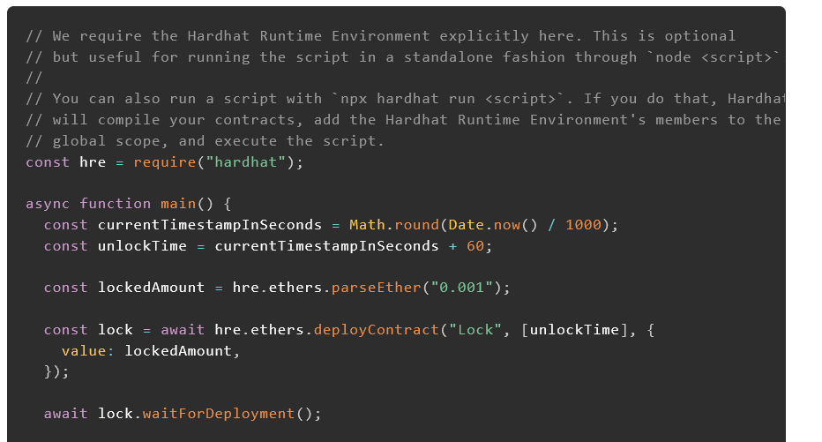




Hardhat – Deploy your contract
Initially open folder scripts
Course3/scripts
Check details
Try npx hardhat run scripts/deploy.js

Slide 14
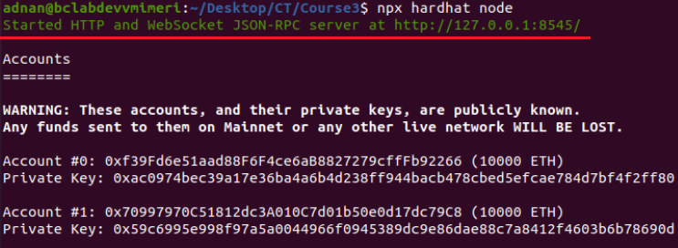
Hardhat – Node/Wallet
Node:
Try npx hardhat node
Our node is running at 127.0.0.1:8545 (localhost)
Deploying your SC in this node
Try npx hardhat run scripts/deploy.js --network localhost
npx hardhat run scripts/deploy.js --network hardhat
localhost- might be occupied by other services

